Slide 1

Sales Prediction Project
Author: Yvon Bilodeau
February 2022

Slide 2
Business Problem
The goal of this project is to help the company better understand the properties of products and outlets that play crucial roles in increasing sales.

Slide 3
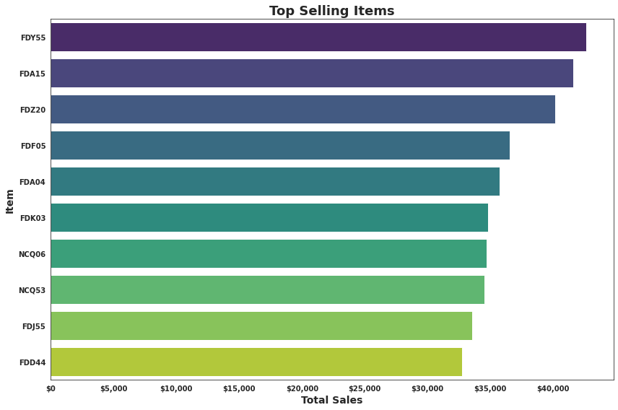
Which items generate the greatest amount of sales?
Some Items sell significantly more than others.
Item FDY55 is the top selling item with $42,662 in sales.

Slide 4
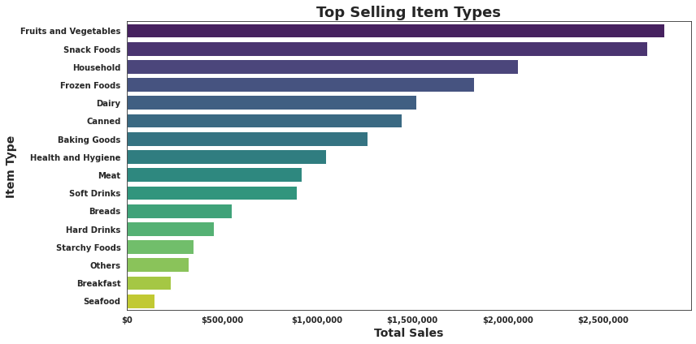
Which Item Type has the highest sales?
The Fruits and Vegetables category is the highest selling category and makes up 16% of total sales.
Convenience food categories come in at 2nd and 4th place with Snack Foods at 14% and Frozen Foods at 10%.
Household Items came in 3rd place with 10%.

Slide 5
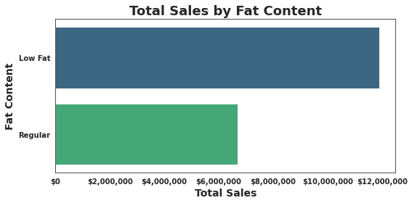
Are consumers health conscious?
Consumers tend to buy significantly more low fat items than regular items.
65% of all sales are low fat items.

Slide 6
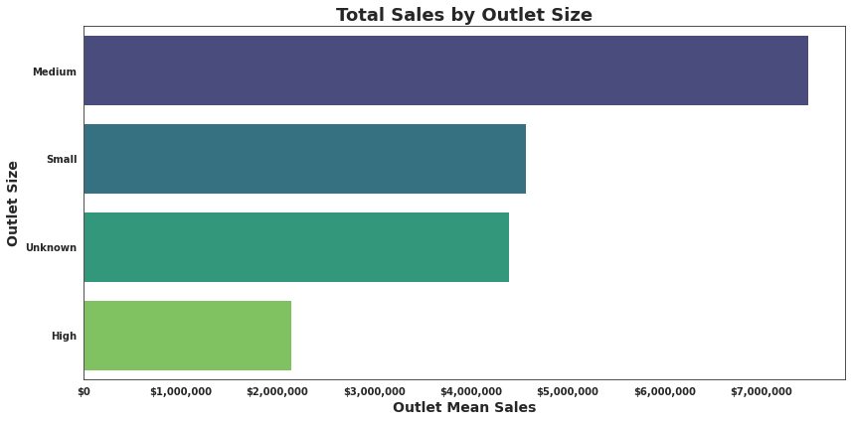
Does Outlet Size affect sales?
The Medium size outlets contributed to 33% of sales, however as 28% of the Outlets had an 'Unknown' size we can not make any assumptions based on this feature.

Slide 7
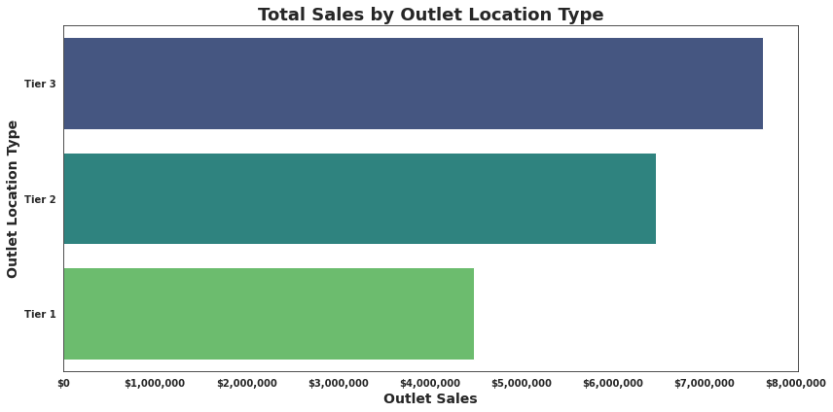
Does Outlet Location Type affect Sales?
Tier 3 Outlet Location Type did contribute the most with 39% sales.

Slide 8
Key Insights
Current consumers tend to eat healthier.
They tend to buy significantly more low fat items than regular items.
They also tend to spend more on Fruits and Vegetables than any other category of item.
Outlet Type contributes greatly to sales.
Type 3 Outlets contribute significantly more than Types 1 or 2.

Slide 9
Recommendations
Future Outlet expansion should consider prioritizing:
Healthy low fat item categories and convenience items
Tier 3 Outlet Location Types

